Slide 1
What is a function
f(x)

Slide 2
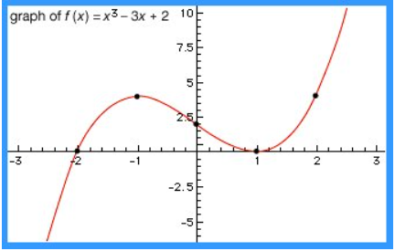
function, in mathematics, an expression, rule, or law that defines a relationship between one variable (the independent variable) and another variable (the dependent variable).

Slide 3
f(x)=5x−3

Slide 4
f(5)= 5(5)-3
= 25-3
= 22

Slide 5
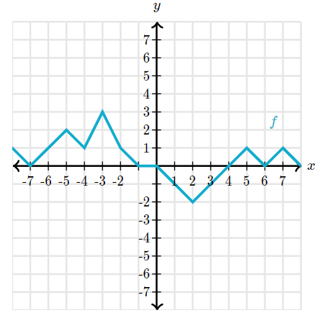
f(2)= ?

Slide 6
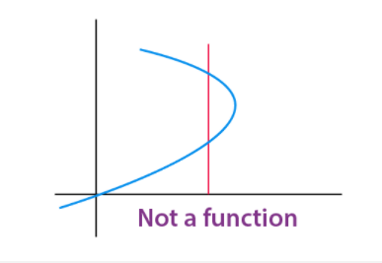
Vertical Line Test:
Vertical line test is used to determine whether a curve is a function or not. If any curve cuts a vertical line at more than one points then the curve is not a function.

Slide 7
Types of Functions
There are various types of functions in mathematics which are explained below in detail. The different function types covered here are:
One – one function (Injective function)
Many – one function
Onto – function (Surjective Function)
Into – function
Polynomial function
Linear Function
Identical Function
Quadratic Function
Rational Function
Algebraic Functions
Cubic Function
Modulus Function
Signum Function
Greatest Integer Function
Fractional Part Function
Even and Odd Function
Periodic Function
Composite Function
Constant Function
Identity Function

Slide 8
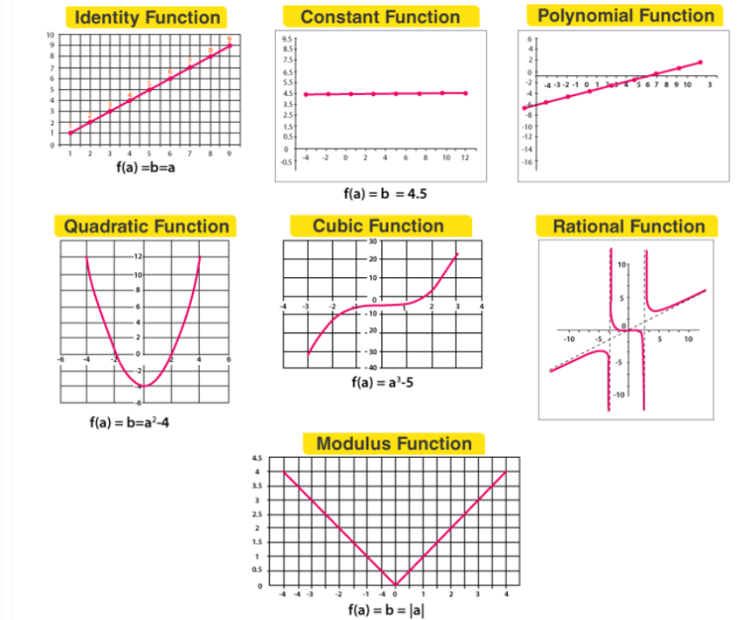

Slide 9
LIMIT

Slide 10
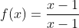

Slide 11
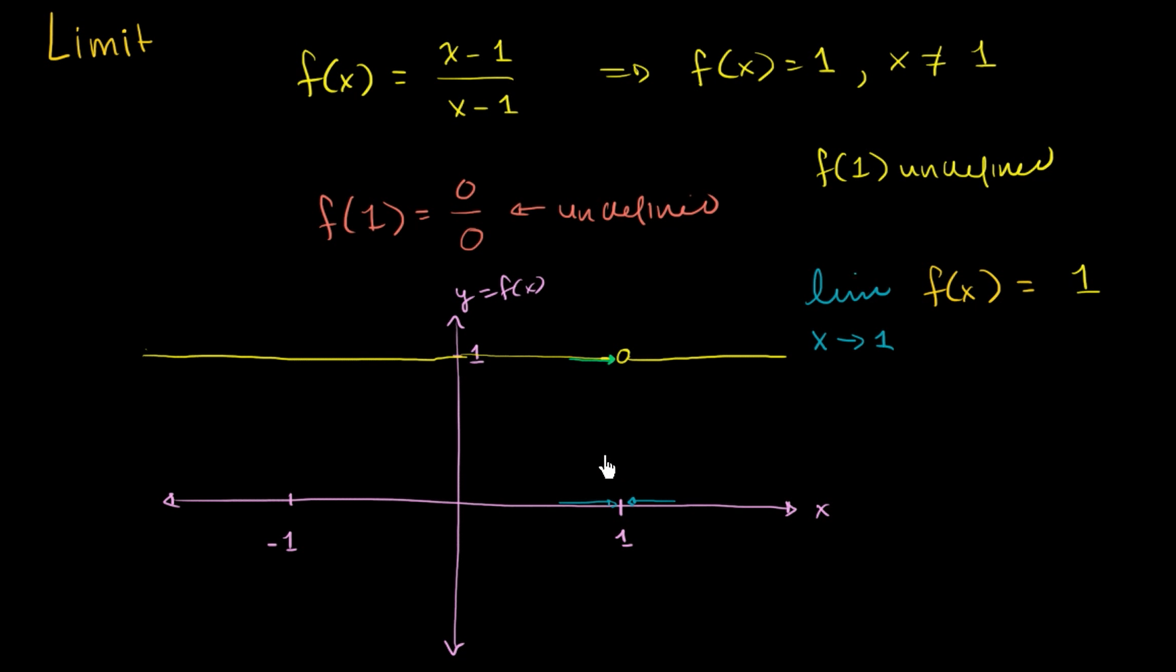

Slide 12
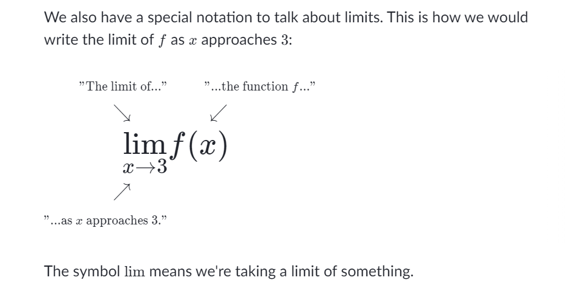

Slide 13
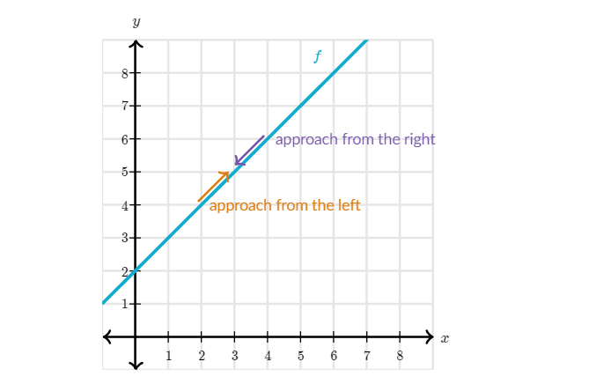
Finding the limit from both direction

Slide 14
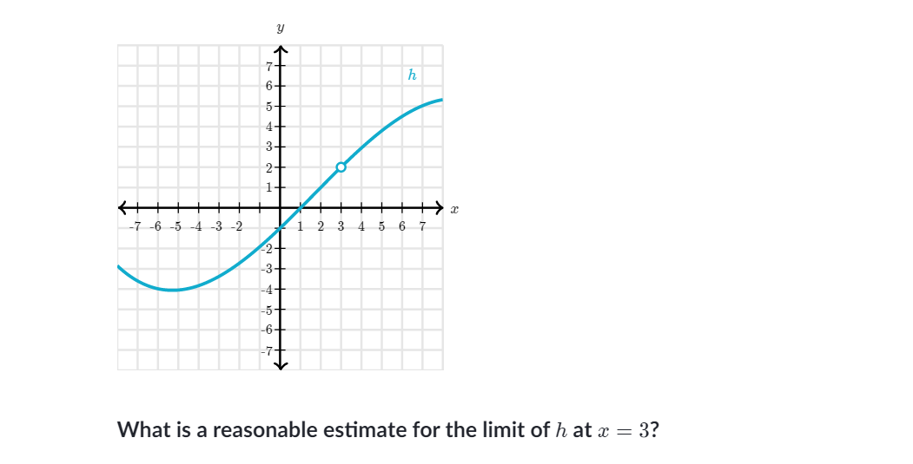

Slide 15
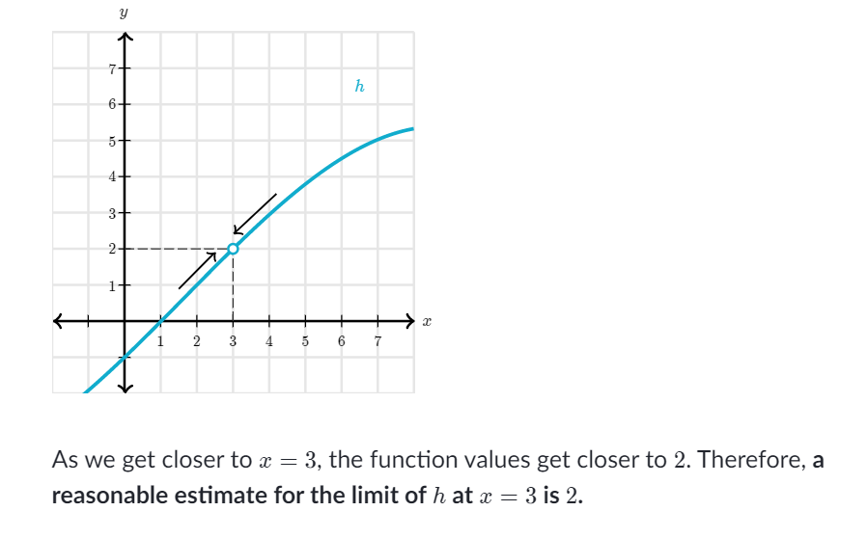

Slide 16
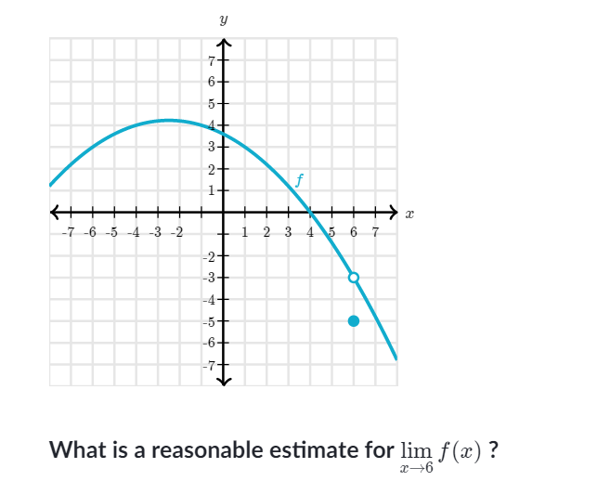

Slide 17
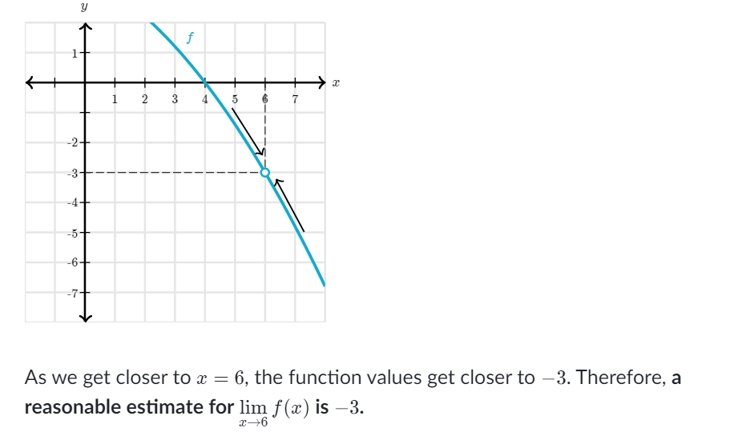

Slide 18
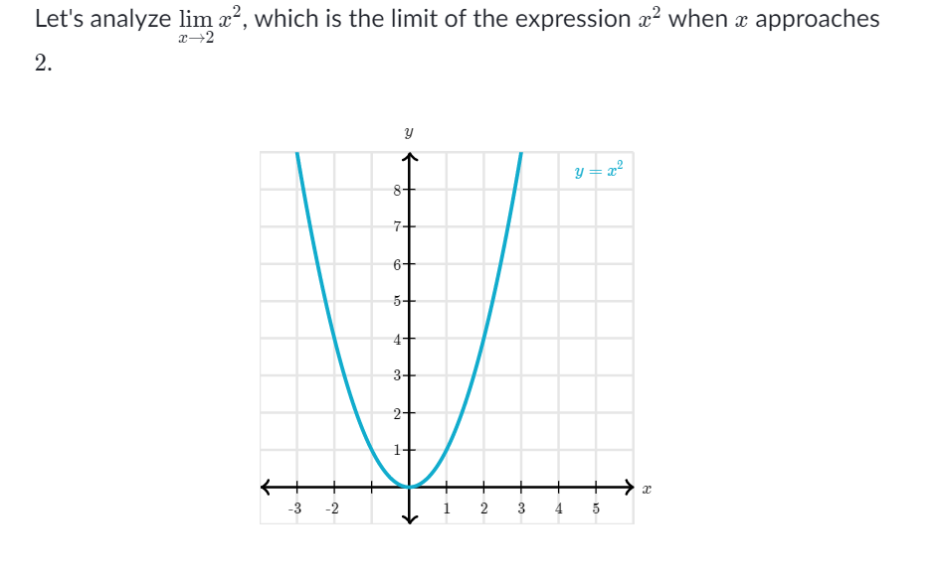

Slide 19
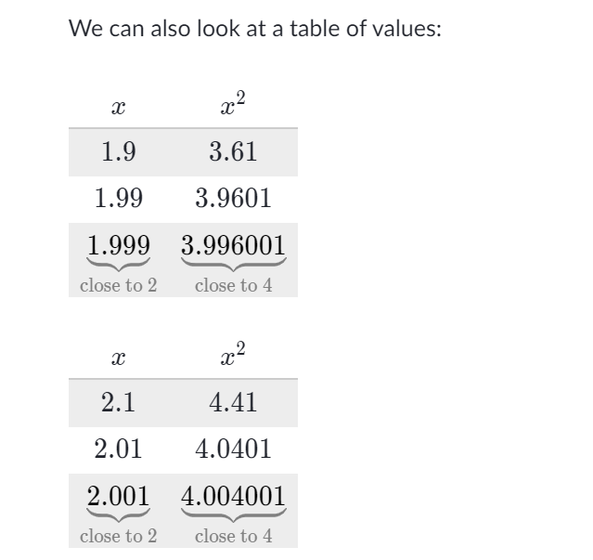

Slide 20
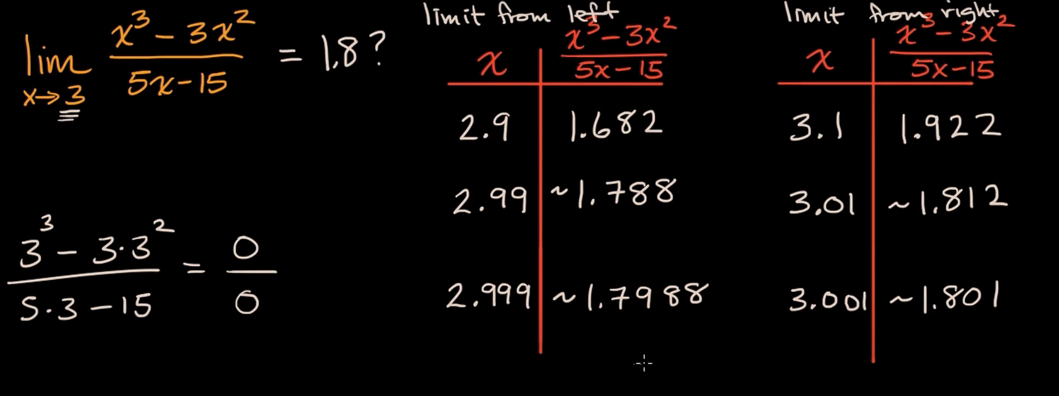
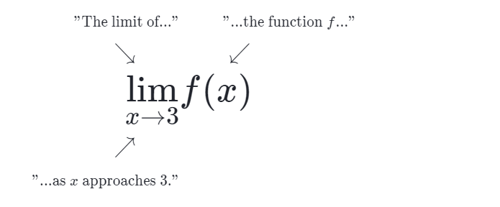

Slide 21
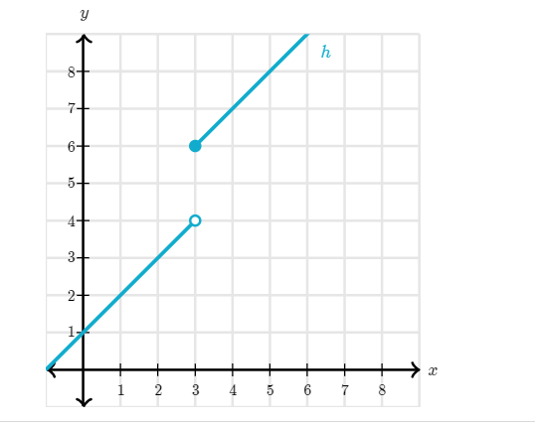

Slide 22
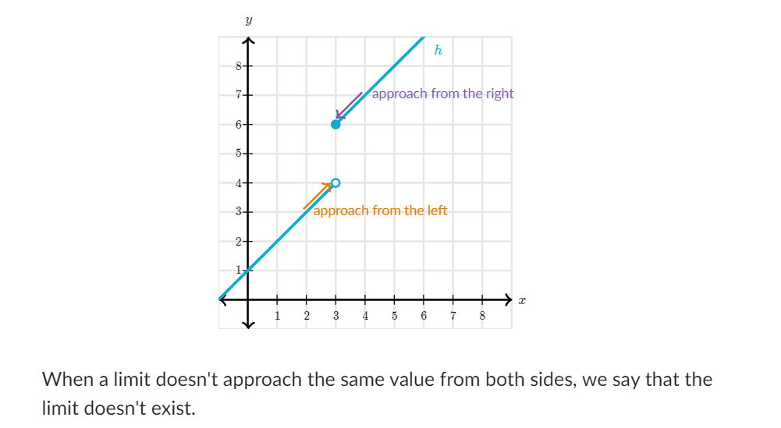

Slide 23
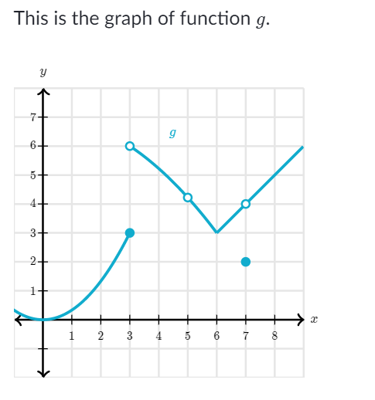
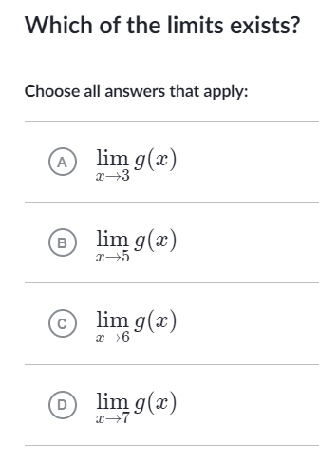

Slide 24
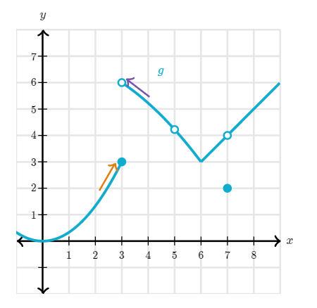
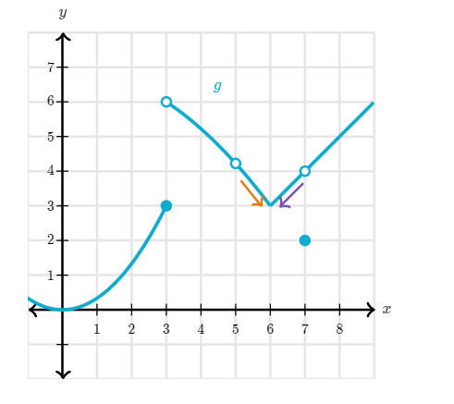
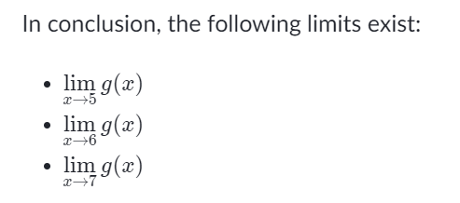

Slide 25
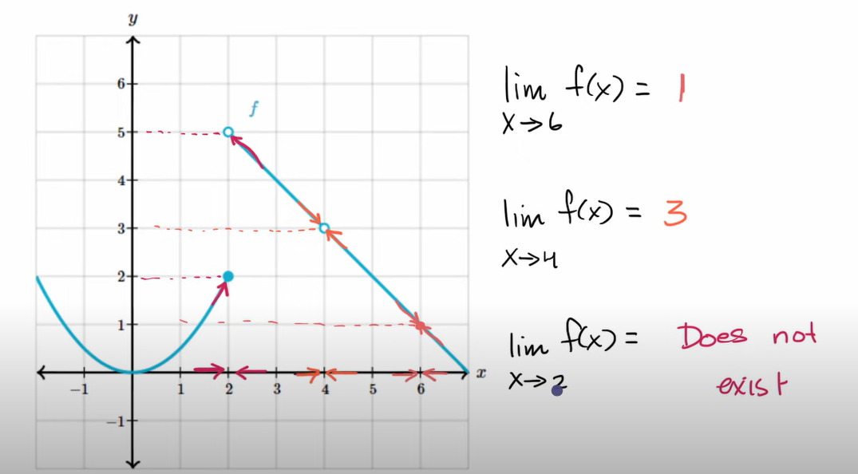

Slide 26
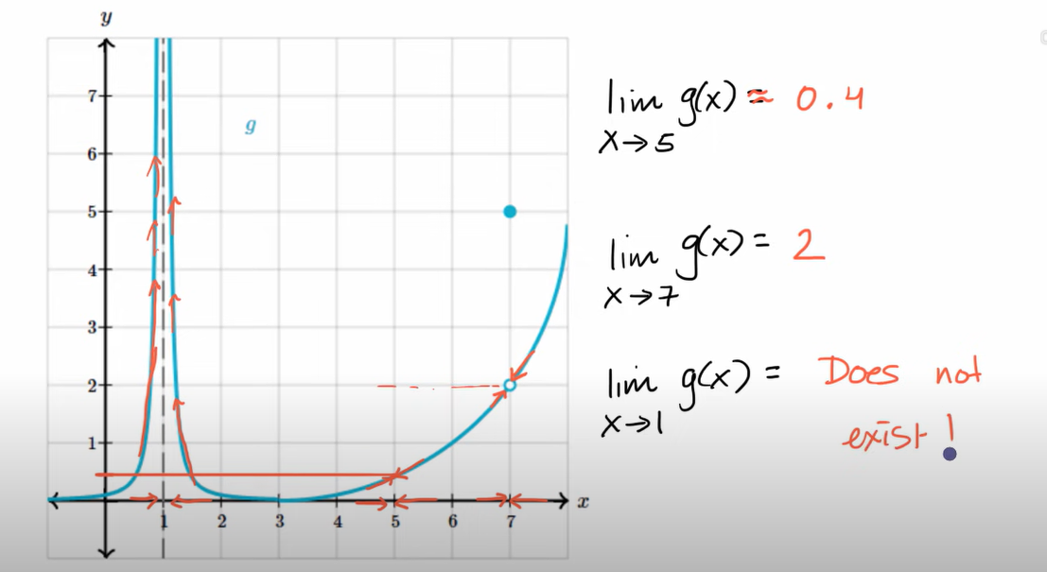

Slide 27
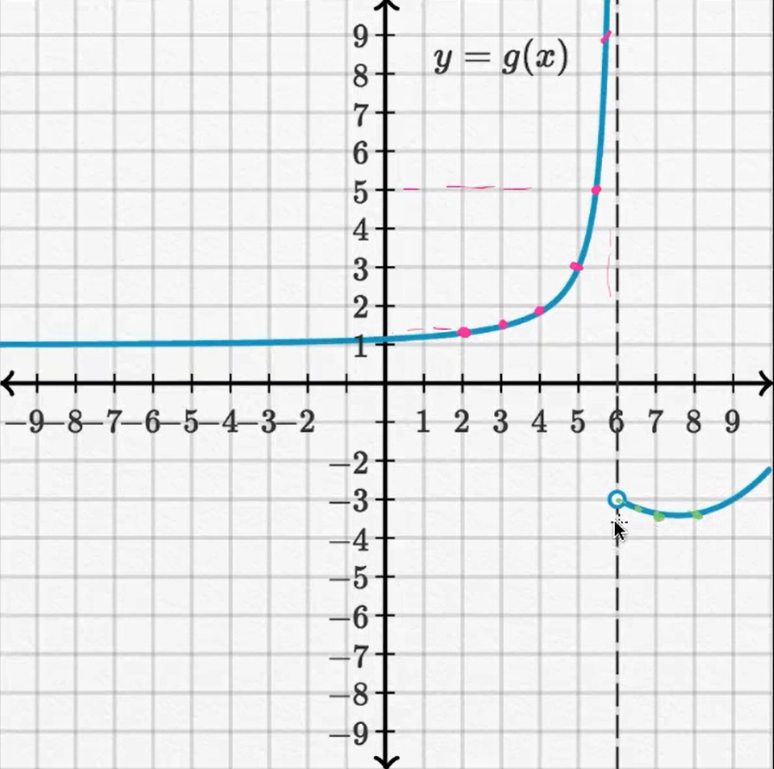

Slide 28
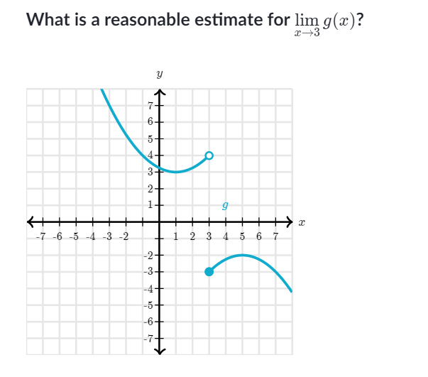
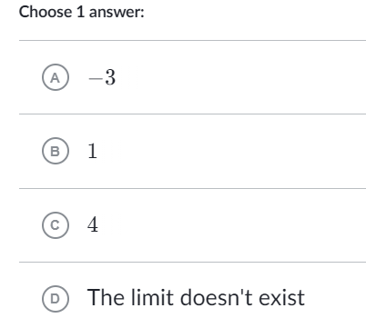

Slide 29
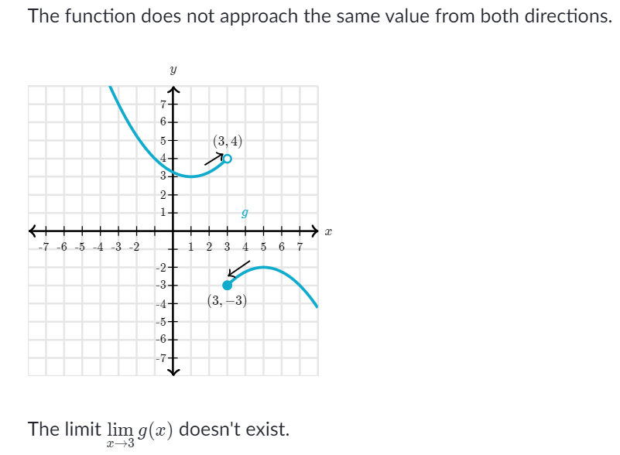

Slide 30
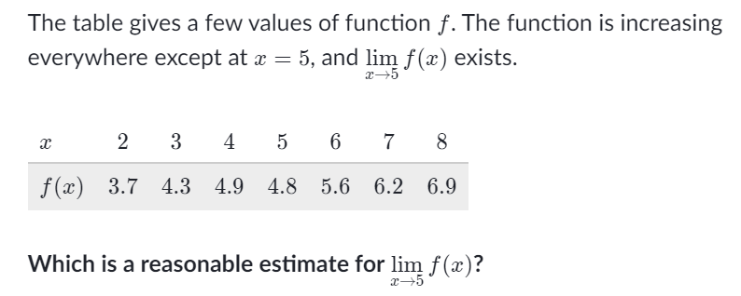
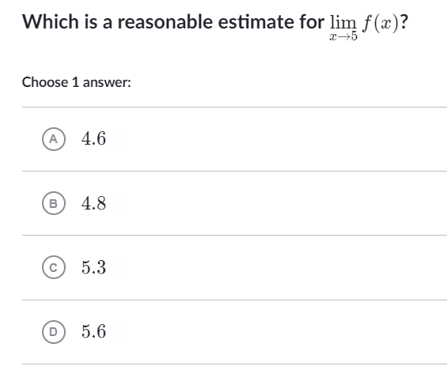

Slide 31
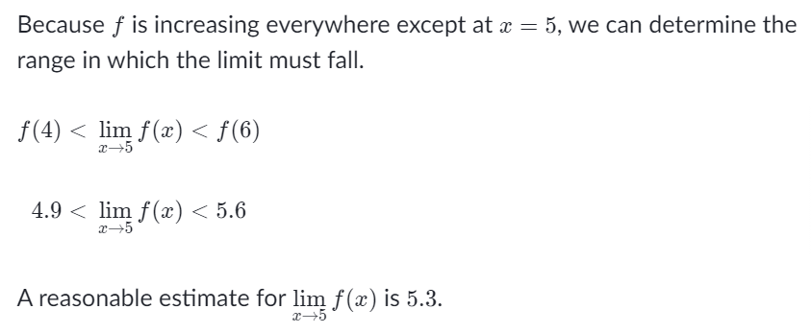

Slide 32

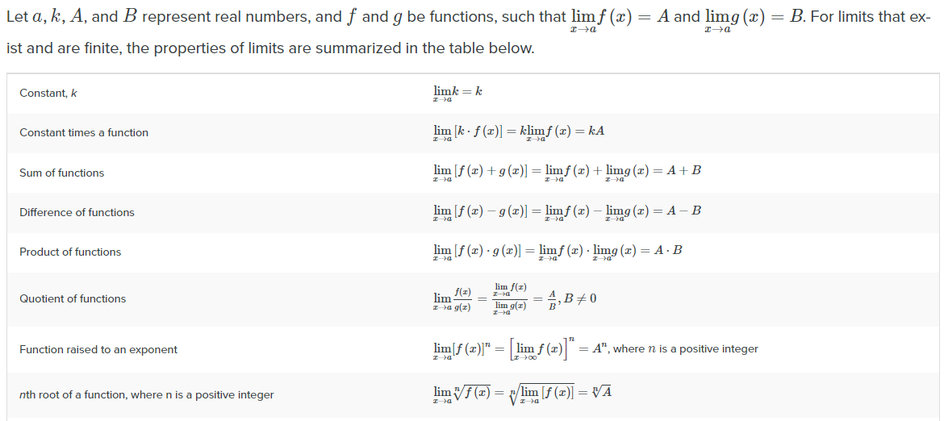

Slide 33
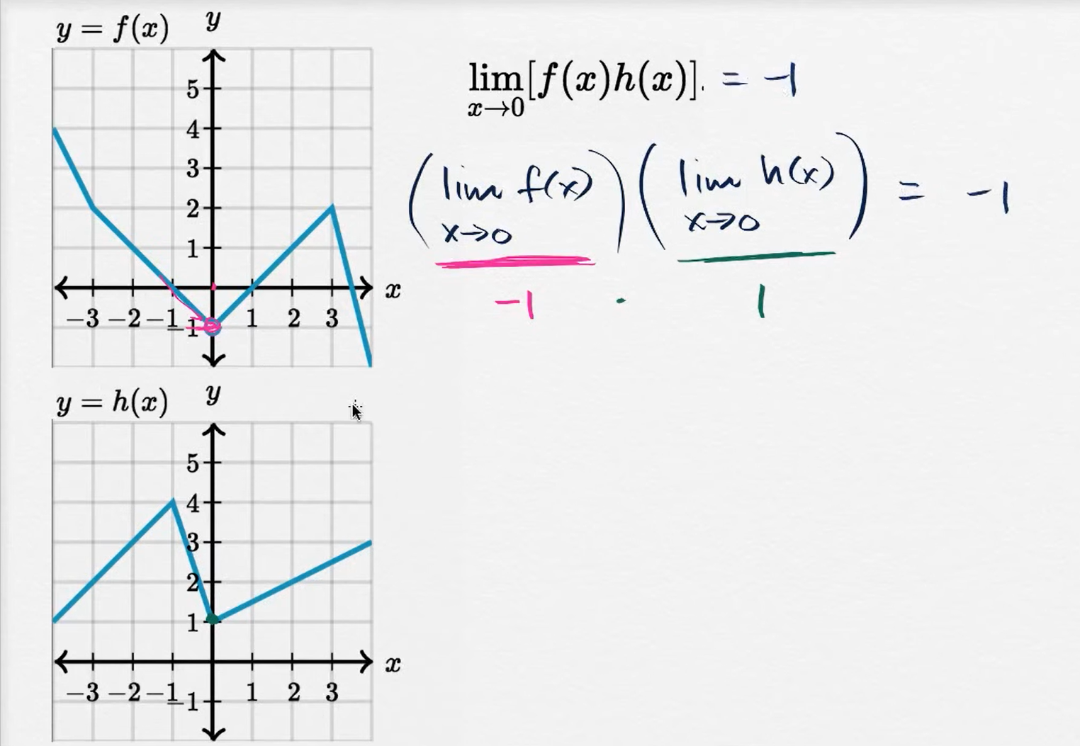

Slide 34
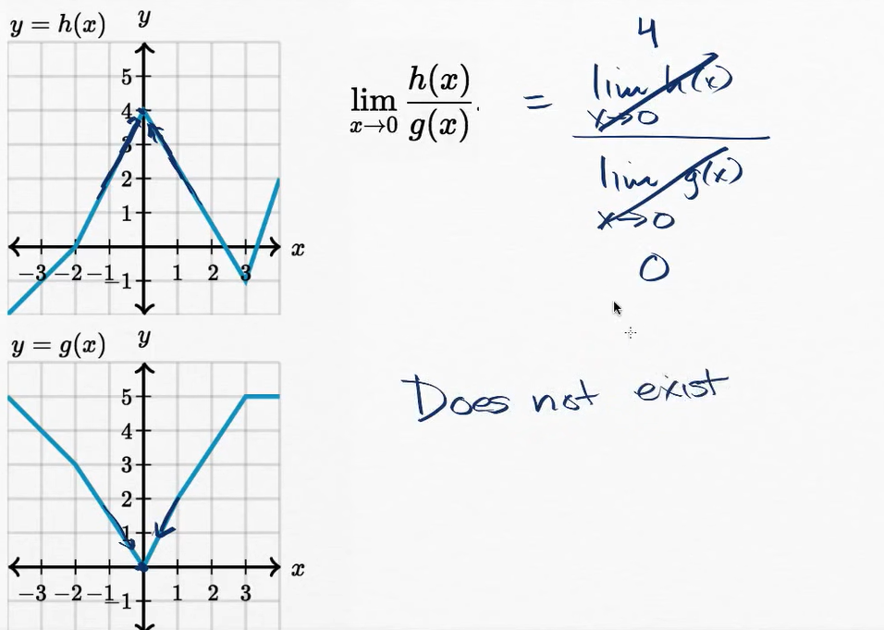

Slide 35
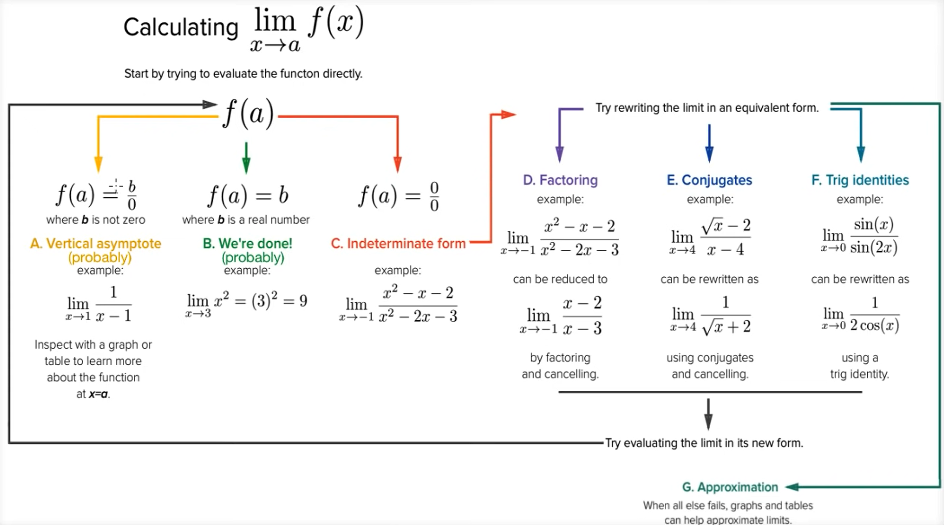

Slide 36
CONTINUITY

Slide 37
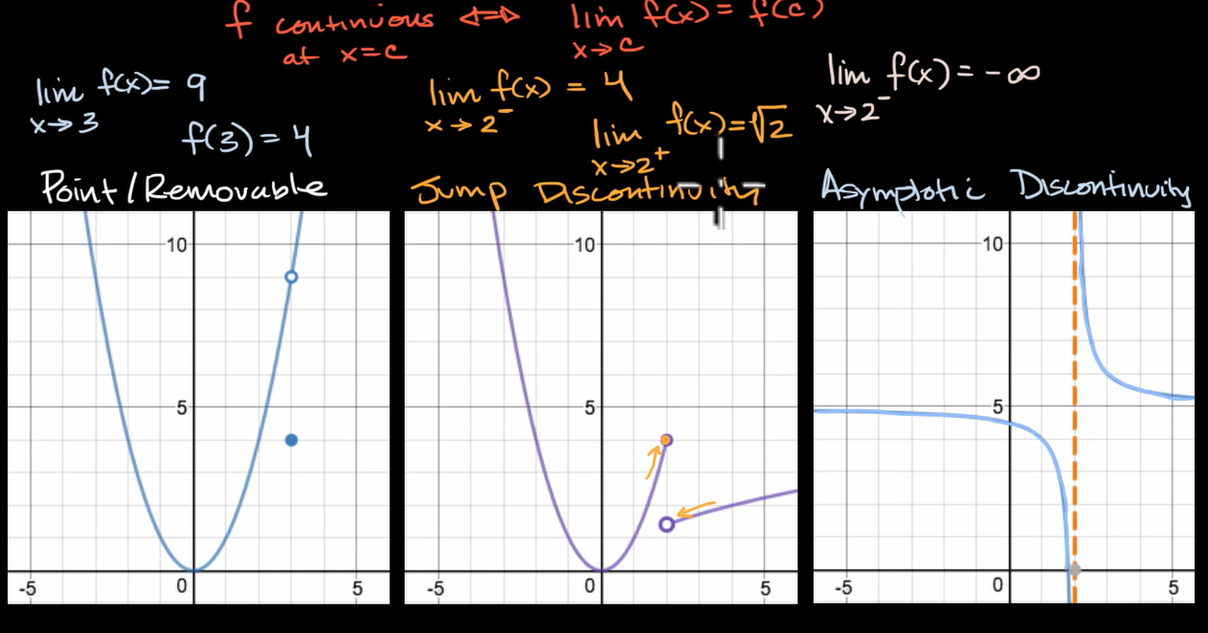

Slide 38
